Slide 1

Project: IP Panel Report: Instruction for molding IP Panel with Grilamid TR XE 4139 black (TR30) For: EUTOP Polymers Industries Date: 20 May 2022
WeHelpInc
Colin Smith
To prepare a systematic training of how to mold IP Panel with Grilamid TR XE4139 (TR30)

Slide 2
Content
Material Handling
Process window of Grilamid TR XE4139 (TR30)
Surface defect from molding process
Weld line
“Pitting” or “streak” on surface
Gloss issue on textured surface
Sink mark
White mark at gate area
Flow mark occur at gate area after heating in 80⁰C water

Slide 3
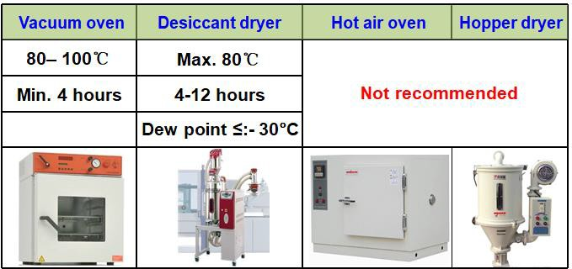
Material handling - Drying
Note: Hot air oven and hopper dryer have no drying effect!

Slide 4
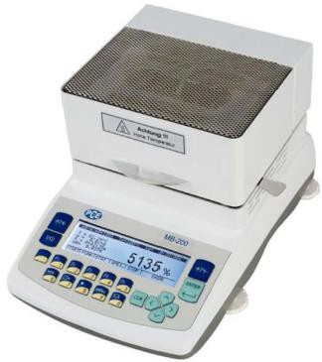
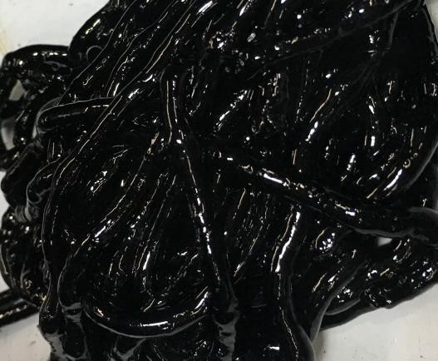
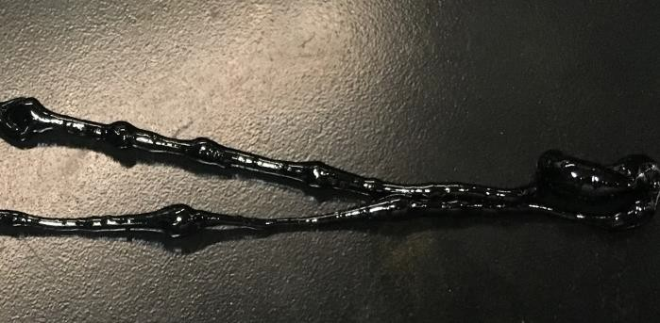
Material handling – Moisture Content
Material moisture content measurement
Chemical test way (Recommend)
Measurement temp 160⁰C
Physical test way (Not recommend)
Measurement temp 160⁰C& > 20mins
Material moisture content requirement
0.02—0.06%
Note: Material moisture content is 0.015% after drying. There is bubble on melt cake. Molded parts occurred small bubble on part surface.

Slide 5
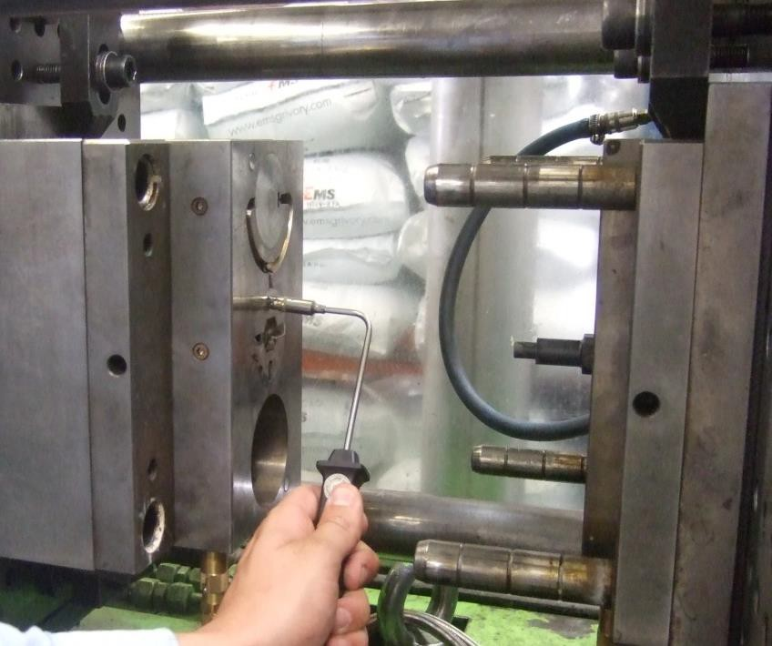
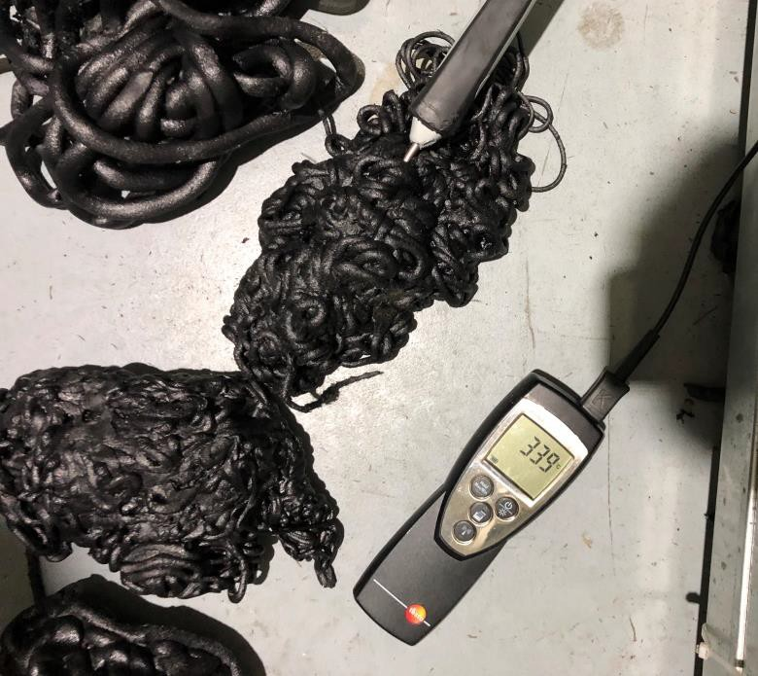
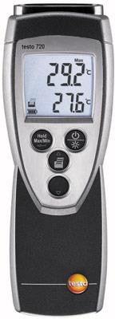
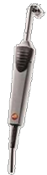
Process of Grilamid TR30 – Temperature Setting
Material melt temperature 290⁰C~310 ⁰C
Mold measured temperature 80⁰C~120⁰C
Actual temperatures are always measured from tool surface and melt cake.

Slide 6
Process of Grilamid TR30 – Screw Select
Standard 3-zone screws with non-return valve are recommended.
L / D – ratio: 18:1 up to 25:1
Compression-rate: 2:1 up to 2.5:1
To prevent black spots formation a special screw coating
Screw utilization ratio
Shoot volume = 30 to 60% of max. shoot volume
Barrel temperature setting high or low should be considered screw utilization ratio. Utilization ratio higher, barrel temperature setting higher.

Slide 7
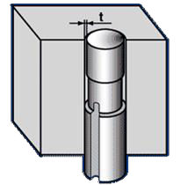
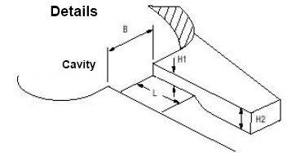
Process of Grilamid TR30 – Tooling Design
Runner and gate diameter
Runner: 1.4 x thickest wall section of the injection moulding part (but minimum 4mm)
Gate: 0.8 x thickest wall section of the moulded part
Venting
Depth: 0.02 - 0.03 mm Length: 2 - 5 mm

Slide 8
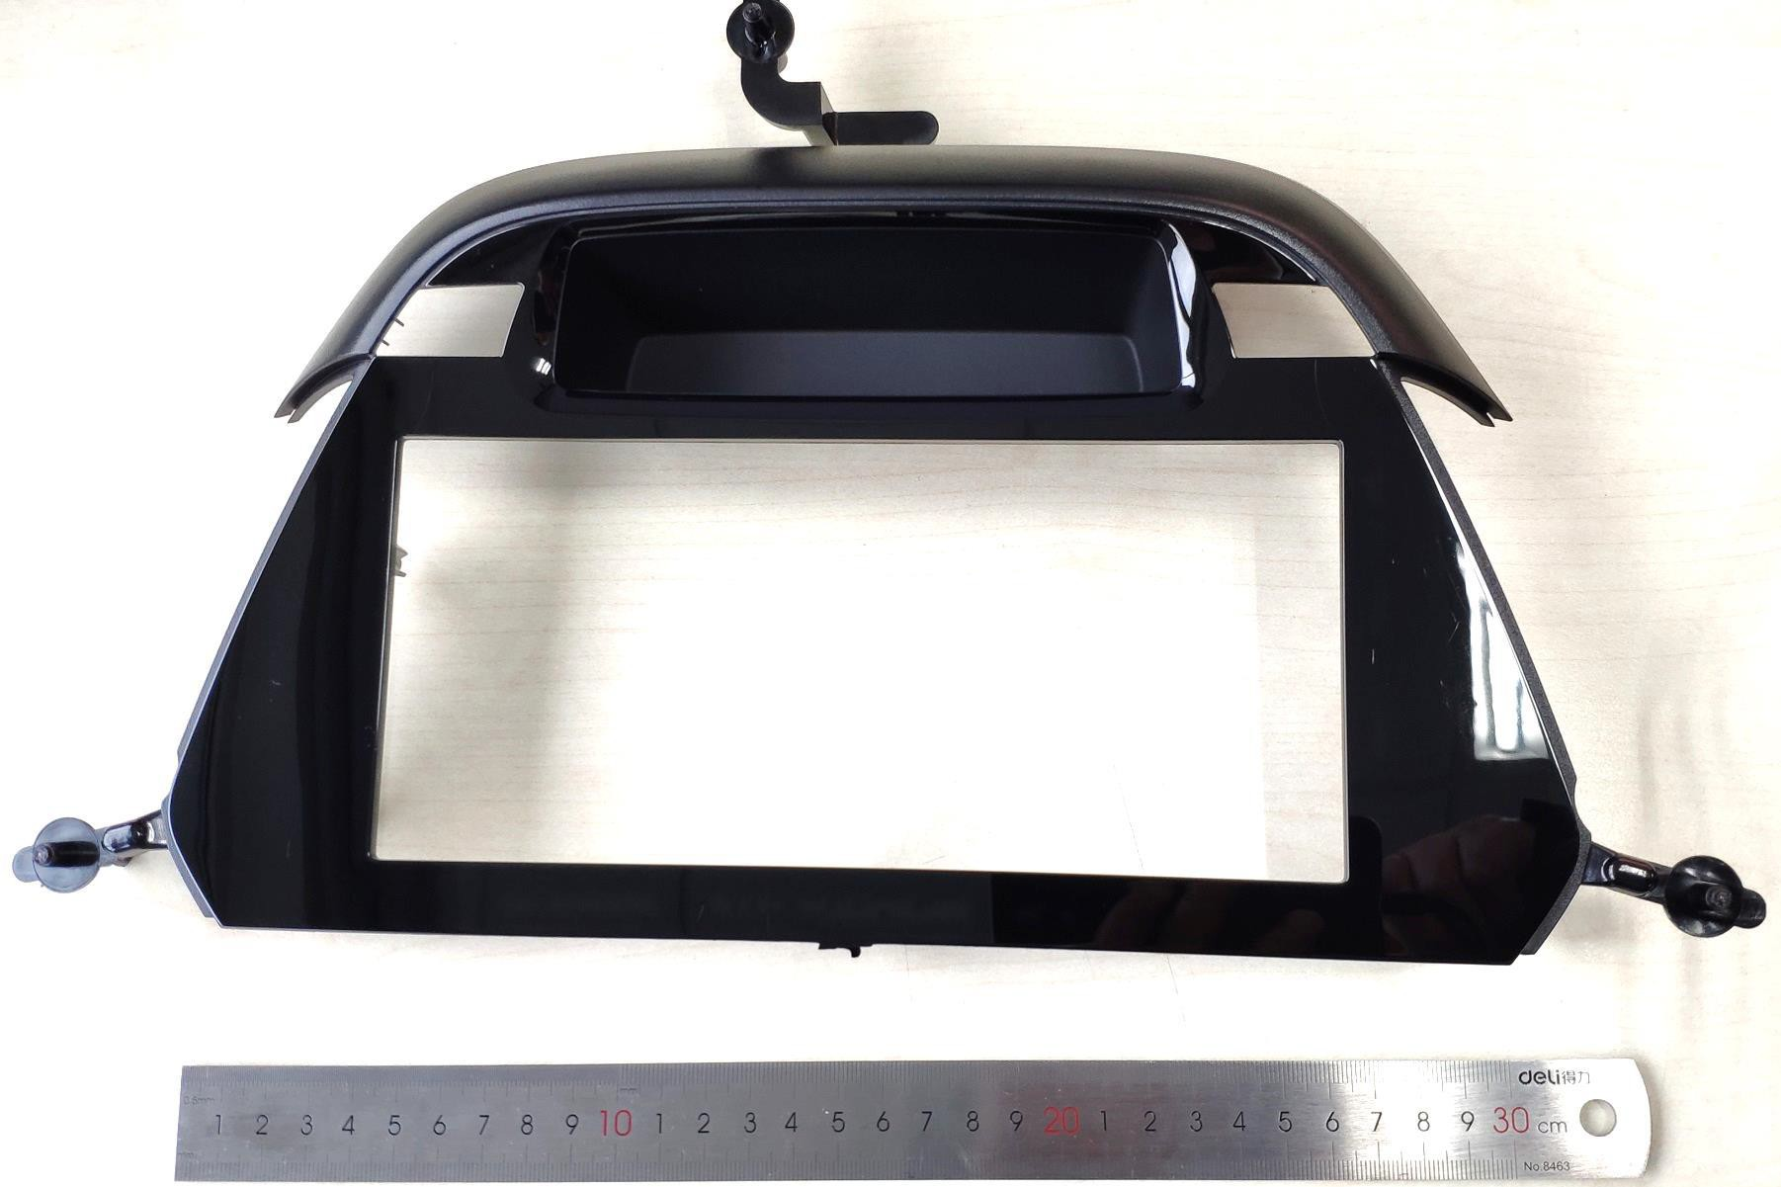
Part Defect Feedback Overview
6
1
2
4
5
3

Slide 9
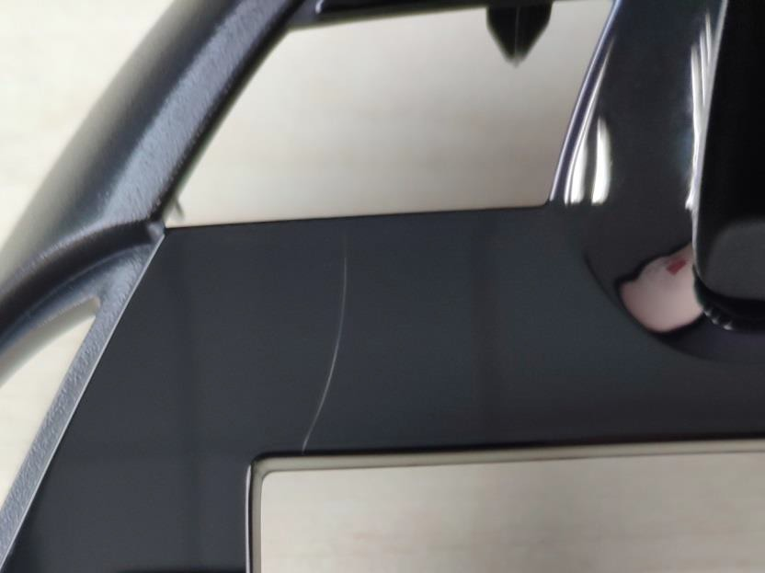
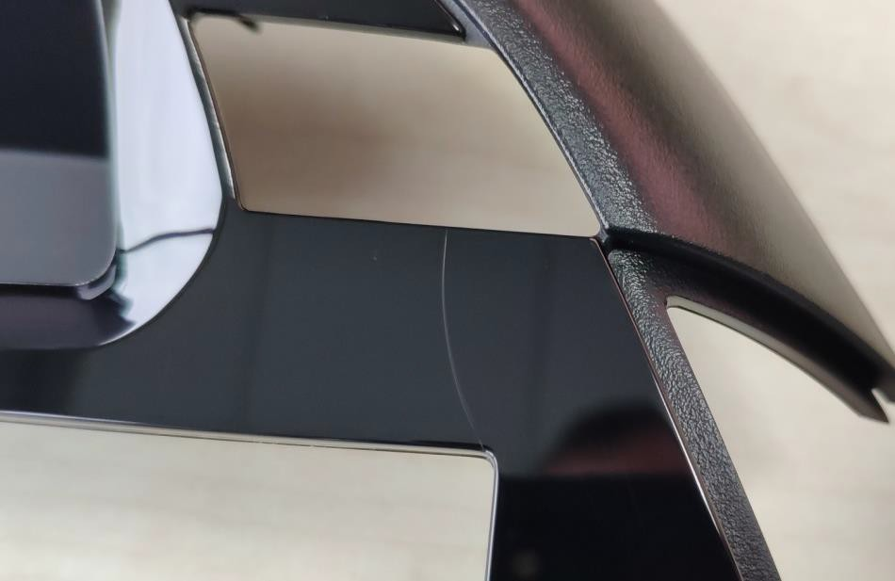
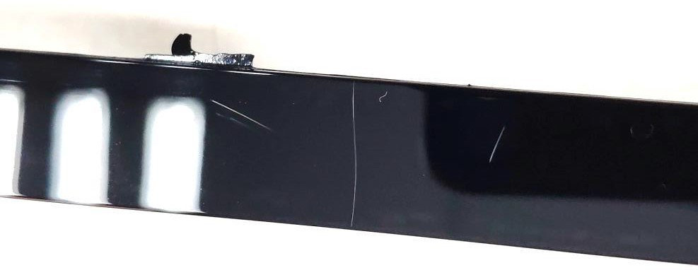
Part Defect: Weldline
Area 1 Area 2
Area 3

Slide 10
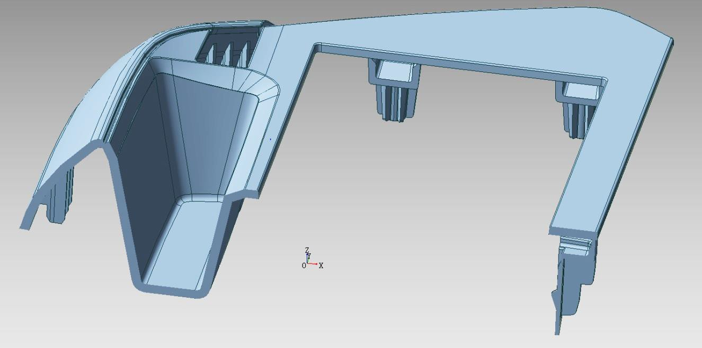
Analysis: Weldline
3 holes on the part lead to weld line defects, which were supposed to be fixed by using RHCM (Rapid Heat Cycle Molding )
Part concave on tool fixed side and cooling channels behind limit the max. surface temp. by RHCM steam heating
Concave structure

Slide 11
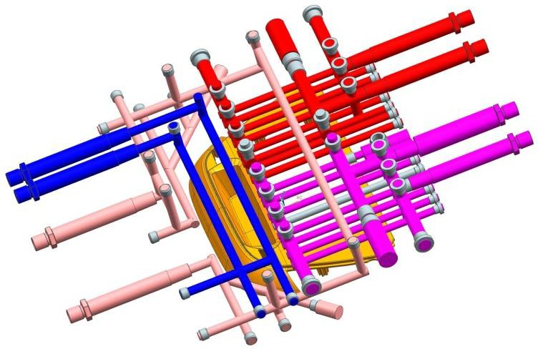
Analysis: Cooling Channel Layout
For welds line on position 1 and 2, both cooling water and steam channels can be found at nearby area. Increasing RHCM steam heating time to achieve higher surface temp causes concave feature sticking to tool fixed side, then part break when mold opening
RHCM
Steam channel 1
Position 2
RHCM
Steam channel 2
Cooling water channel 1
Remark
There supposed to be 4 bubbler pipes inside the concave, but not shown here.
Cooling water channel 2
Position 1

Slide 12
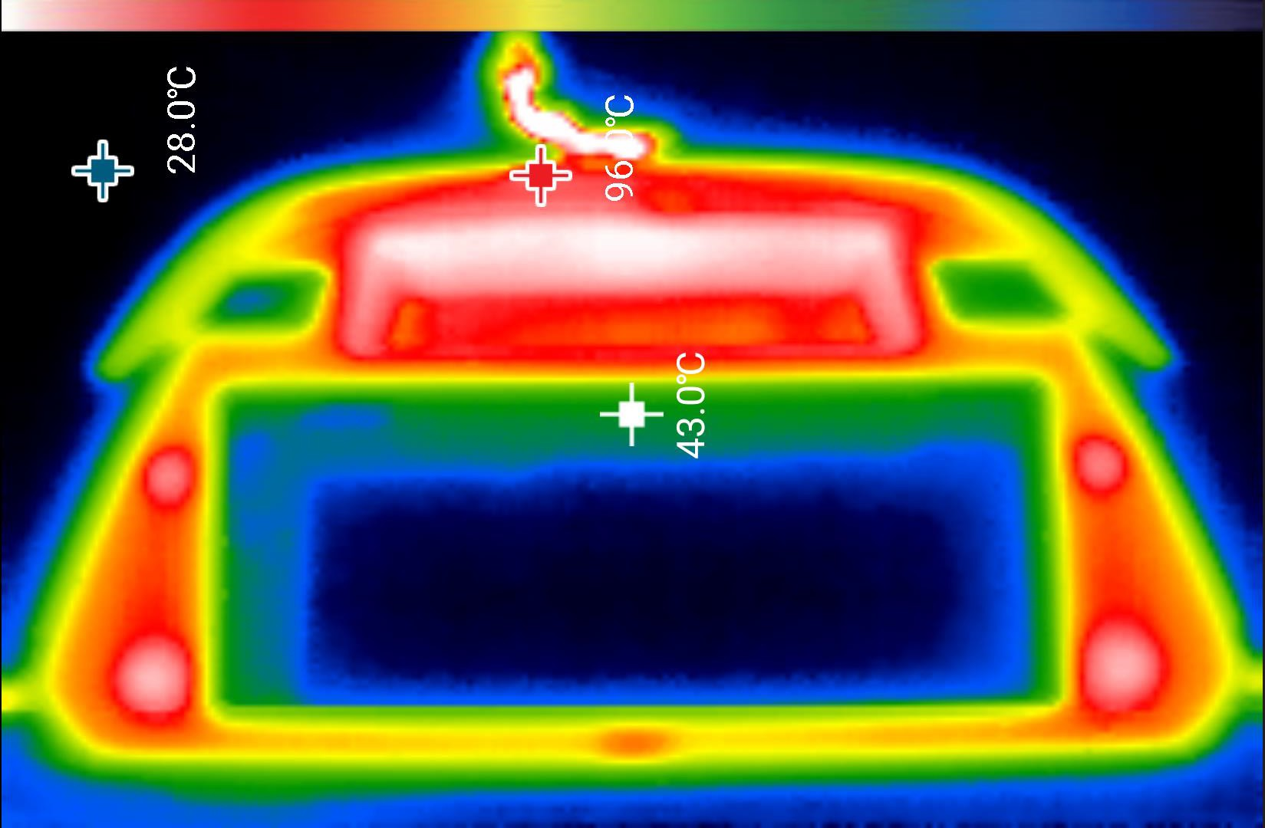
Surface Temp of Part after Demolding

Slide 13
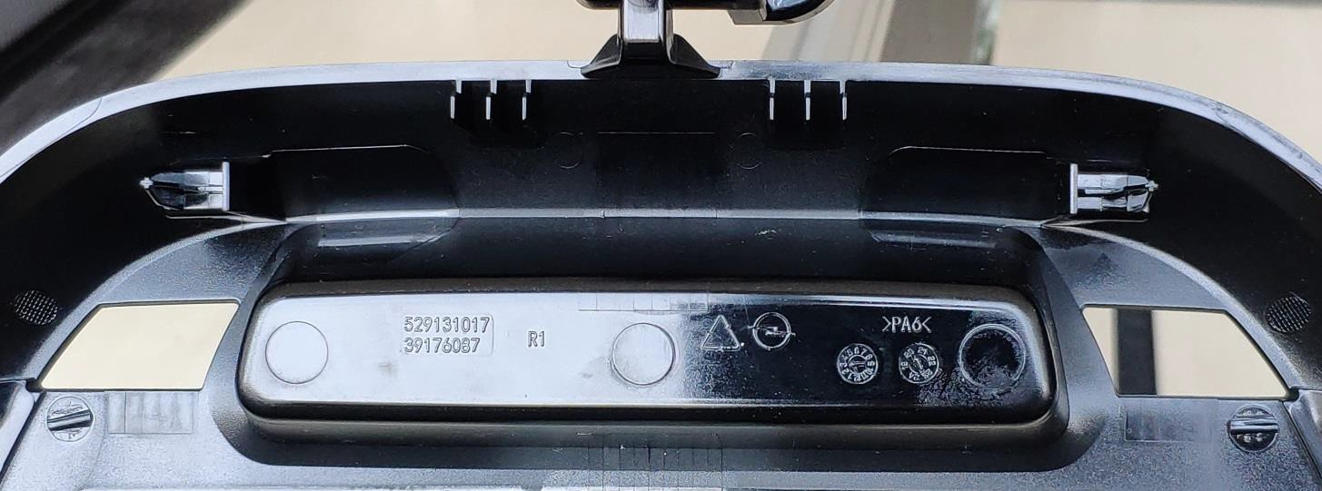
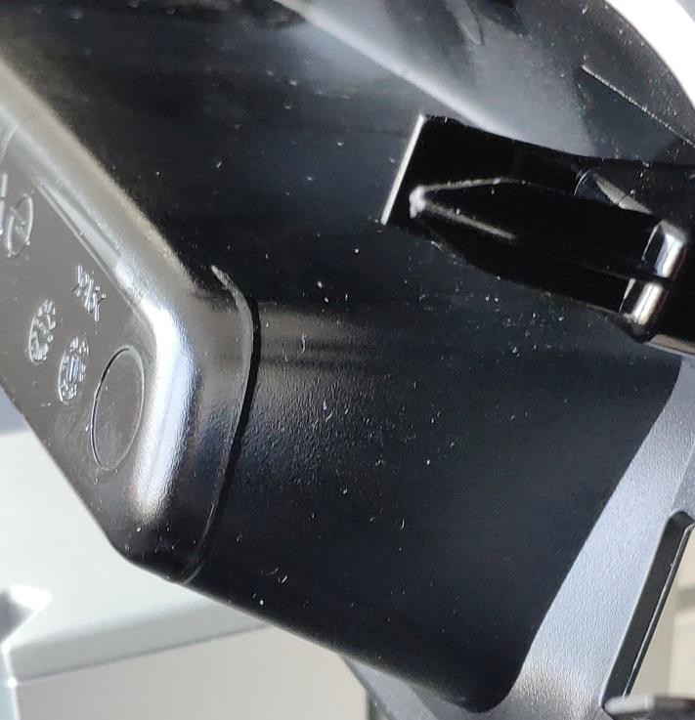
Suggestion: Weldline
Solve the part sticking issue firstly, so to use longer steam heating to fix surface welding line
Current undercut at ends of the structure are weak. Suggest to add more undercuts on ejector side to keep the part to tool moving side when mold opening in case sticking issue occurs once high temp. was applied

Slide 14
Part Defect Feedback Overview
6
1
2
4
5
3

Slide 15
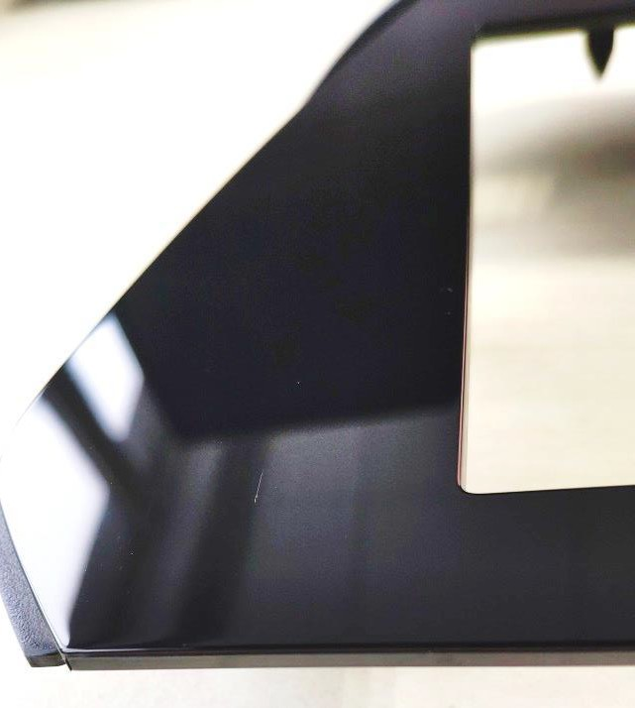
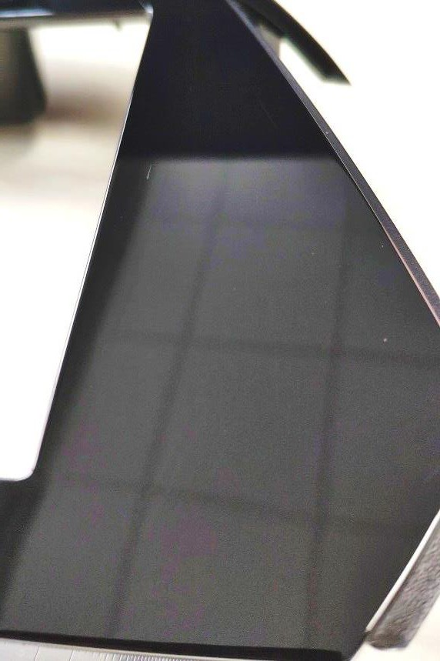
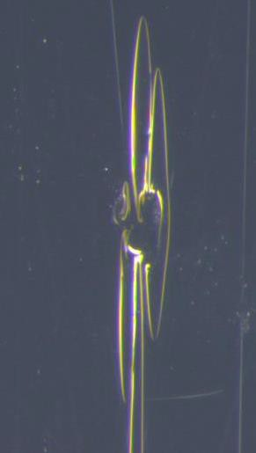
“Pitting” or “Streak” on Surface
Area 4
Area 5

Slide 16
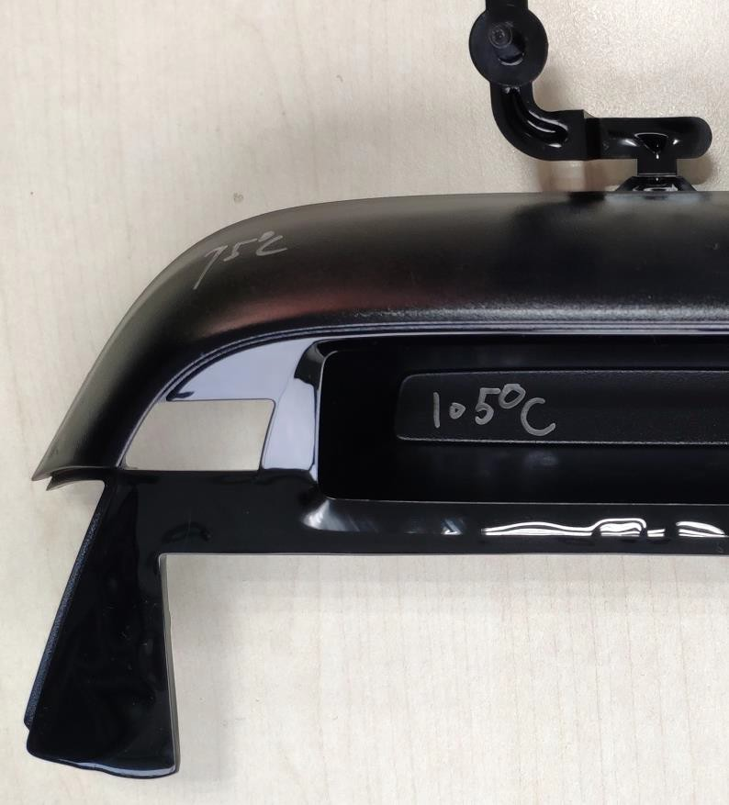
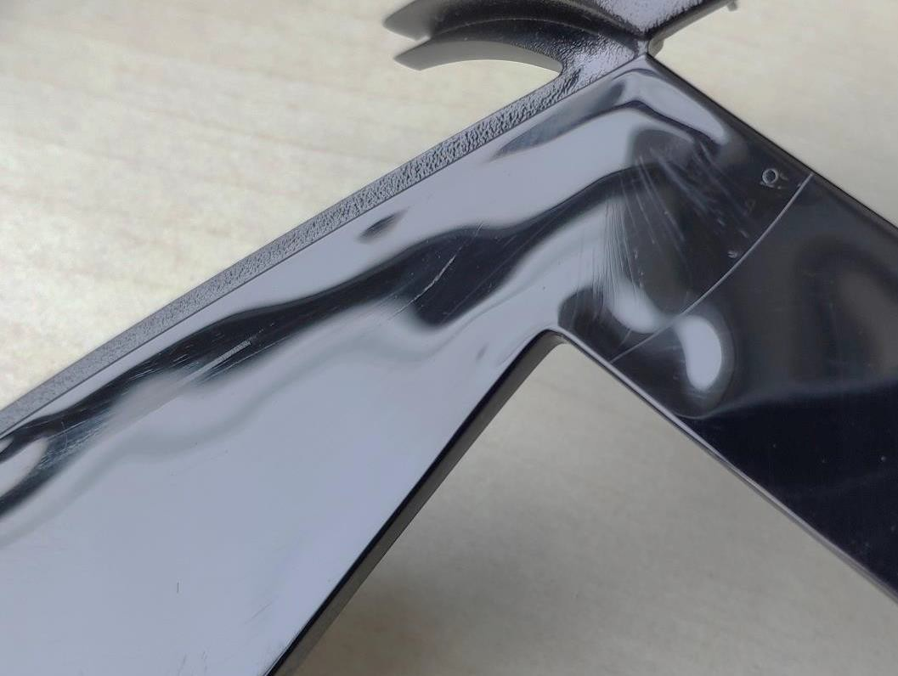
Analysis: “Pitting” or “Streak” on Surface
When melt resin goes through the small channel to a wide space might cause “Jetting” issue. Most defects in this area are relevant to it
The defect “streak” or “pitting” on surface most likely are bubbles in different forms when melt spread into big space
Small channel
16

Slide 17
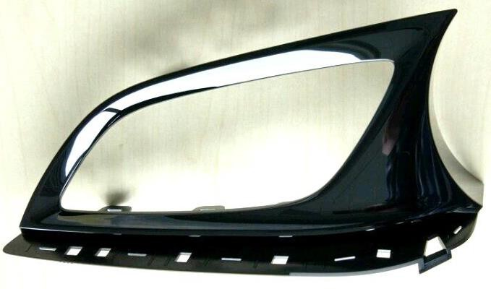
XE4139 Air Vent Trim Surface Defect
Area 2
Area 1
17

Slide 18
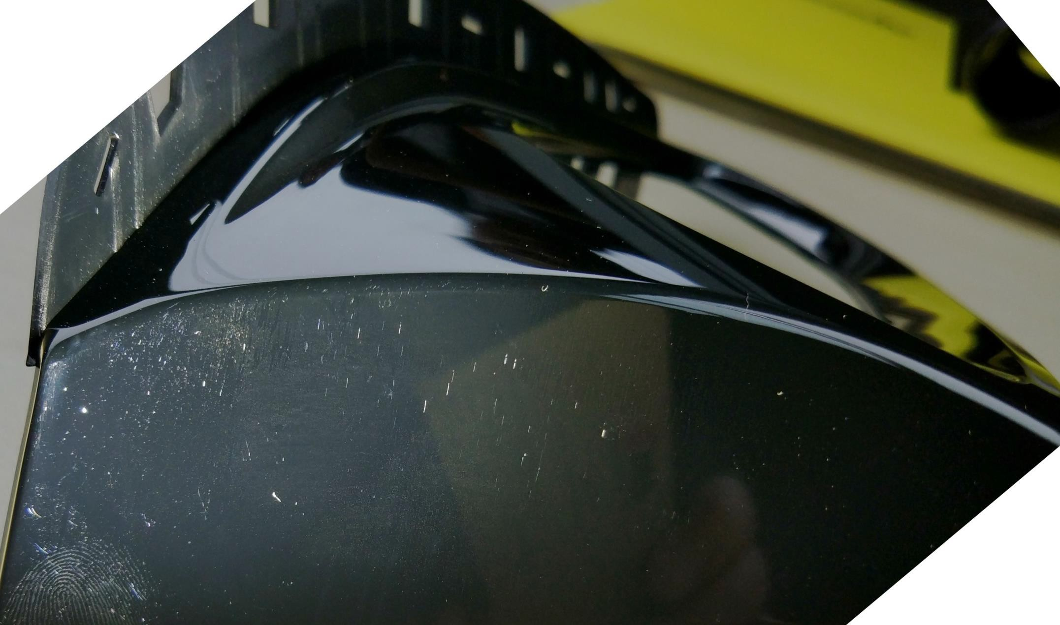
XE4139 Air Vent Trim Surface Defect
Area 1
White streak or spot shape defect
18

Slide 19
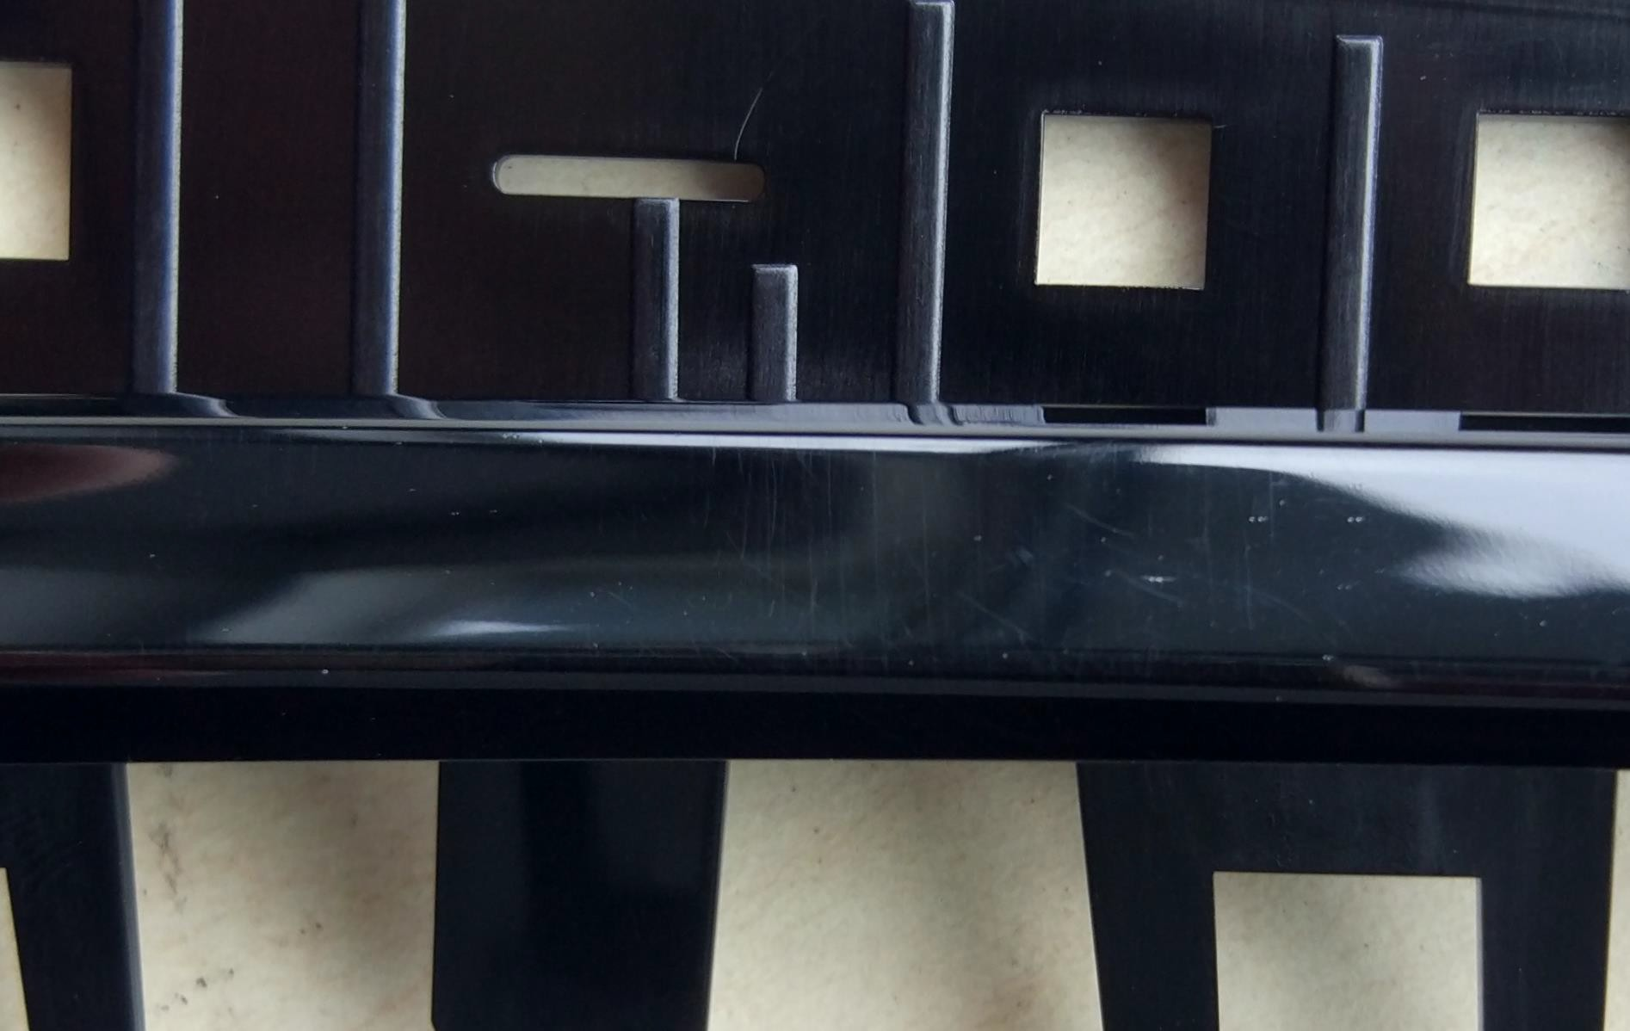
XE4139 Air Vent Trim Surface Defect
Area 2
White streak or spot shape defect on curved surface
19

Slide 20
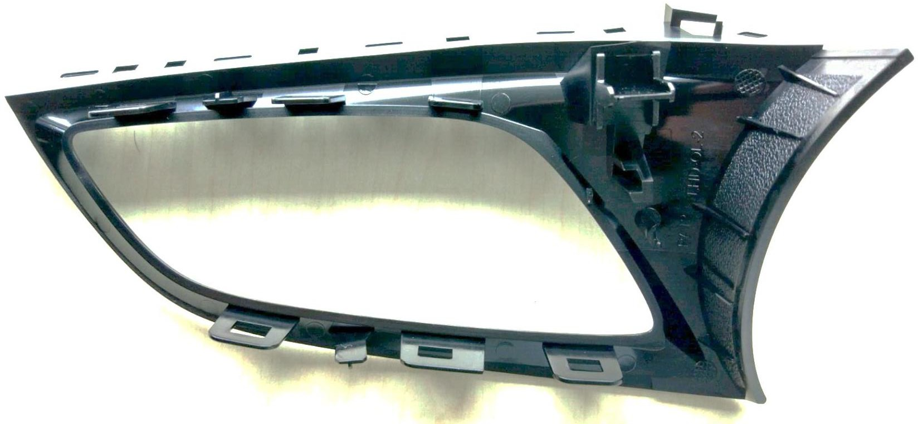
XE4139 Air Vent Trim Surface Defect Analysis
Analysis: Demolding problem on curved surface
With current gate layout, melt was pushed into cavity via gate close to curved surface, to reach the far end of the part where defect area 2 lies, it needs very high injection speed and also pressure, which causes over packing at curved surface, it results demolding issue at curved surface
Current Gate
20

Slide 21
XE4139 Air Vent Trim Surface Defect Analysis
Analysis: pitting defect at far end of flow
During molding trial, 2 mold temperature controllers are used, 100 degree C to fixed side and 80 degree C to moving side as normal setting. With this setting, the fixed side measured temperature is about 90 degree C.
Here low surface temperature brings problem to duplicate the high polished surface. And it also reduce the melt flow ability, which forces the injection machine export more pressure to fill the cavity, this will make the demolding issue worse.
21

Slide 22
Suggestion: XE4139 Air Vent Trim Surface Defect
Suggestion: Gate Layout
To solve the over packing issue in curved surface area, it’s better to add another gate so reduce the cavity pressure are curved surface
22

Slide 23
Suggestion : XE4139 Air Vent Trim Surface Defect
Suggestion: Processing Parameters
Grilamid TR XE4139 has a very high glass transition temperature 160 degree C, it ensures the surface anti-scratch performance, but also makes melt flowing ability sensitive to temperatures.
A mold surface actual temperature 110 to 120 to fixed side is suggested to make sure the melt front temperature not drop too fast
23

Slide 24
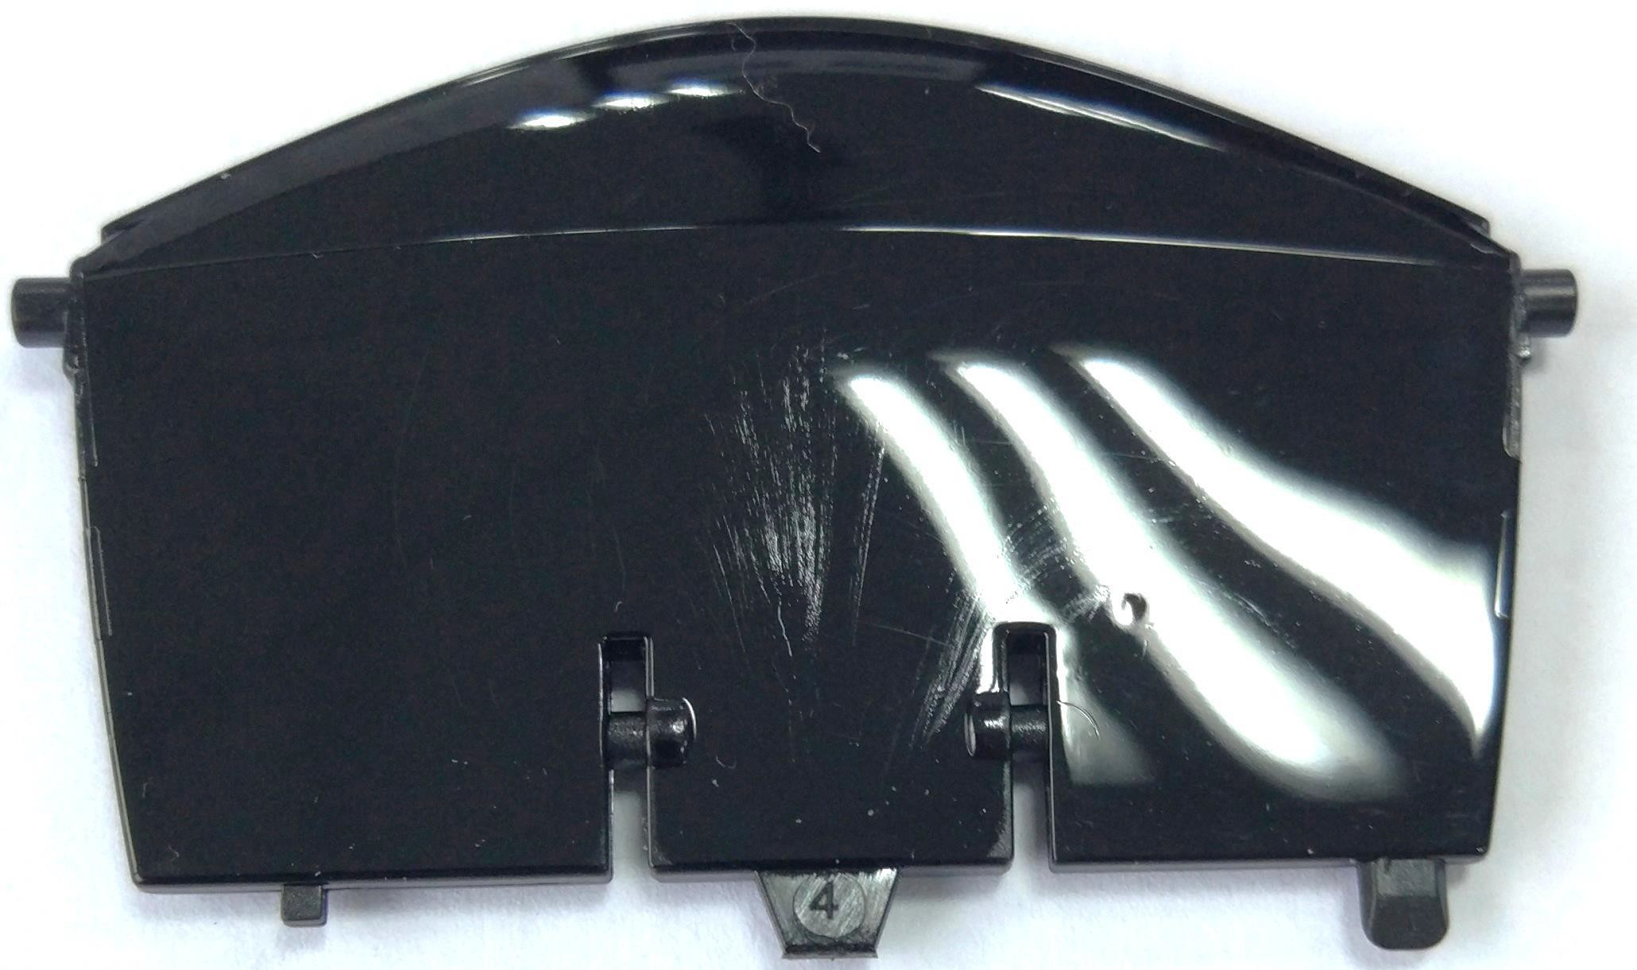
More cases
24

Slide 25
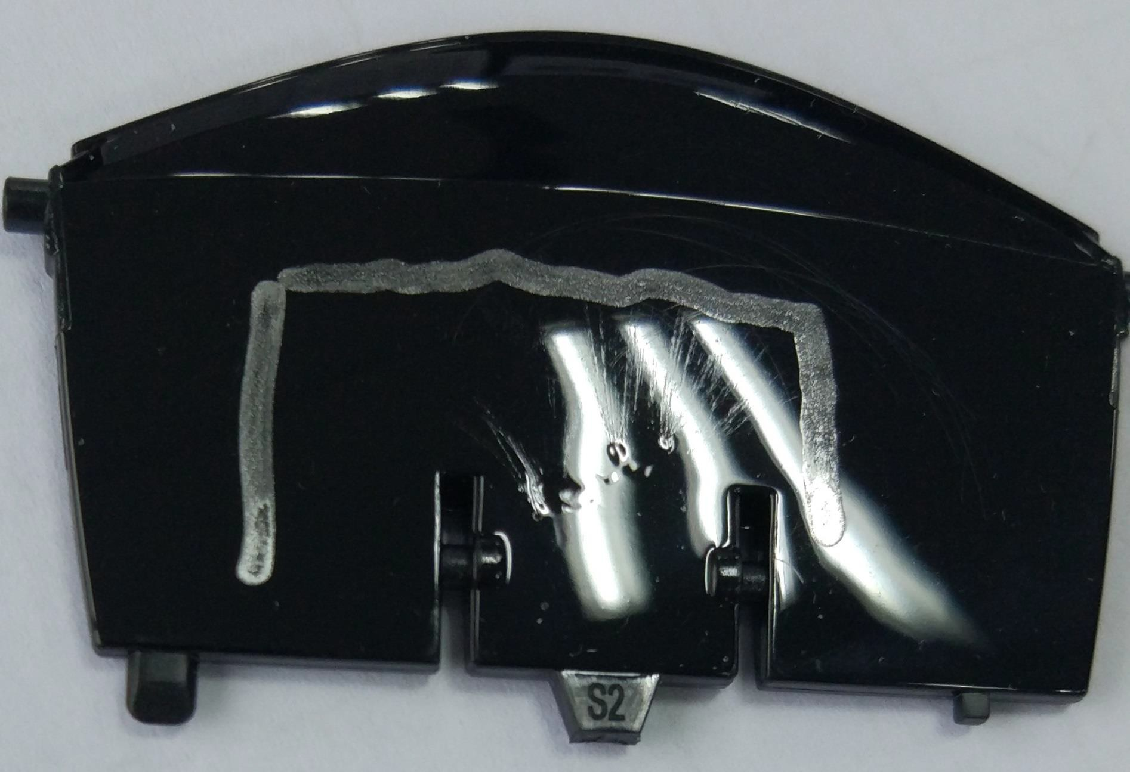
More cases
25

Slide 26
Suggestion: “Pitting” or “Streak” on Surface
Higher tool surface temp. and fast filling can improve this issue
Sufficient pellets pre-drying to make sure moisture content of granule below 0.05%
Suitable gate size to avoid thermal degradation from high shearing
Avoid any contamination
26

Slide 27
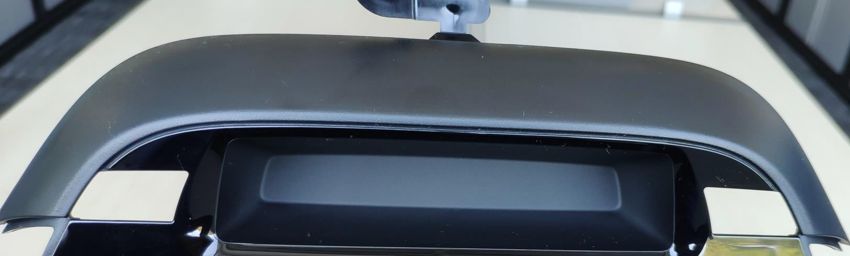
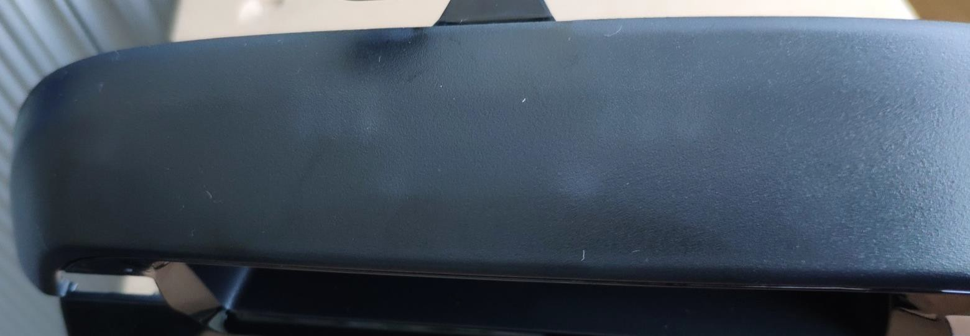
Gloss Issue on Textured Surface
Area 6: Different gloss of 2 textured surfaces (designed with same type of texture)
Outer surface More shining
Inner surface More Matt
Area 6: uneven gloss distribution on outer textured surface
27

Slide 28
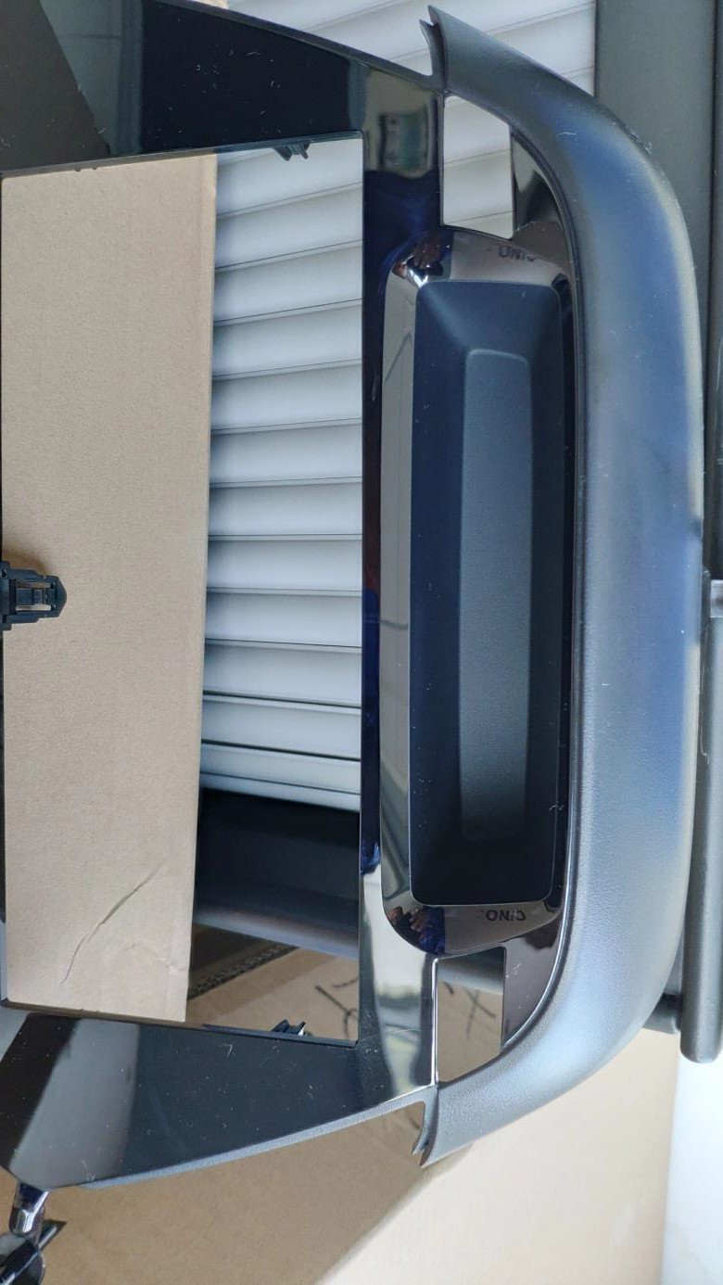
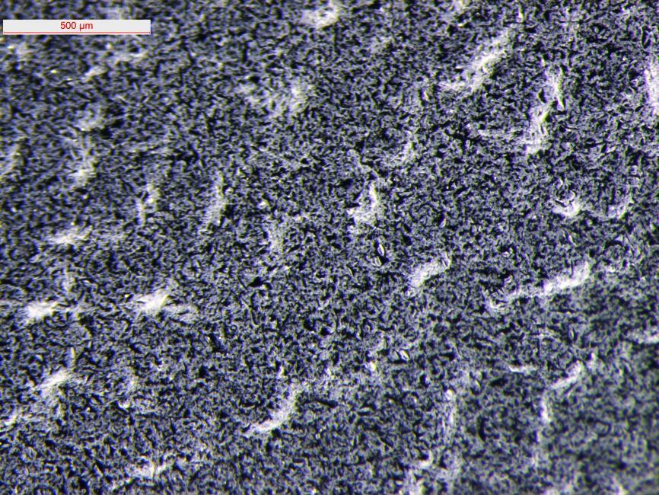
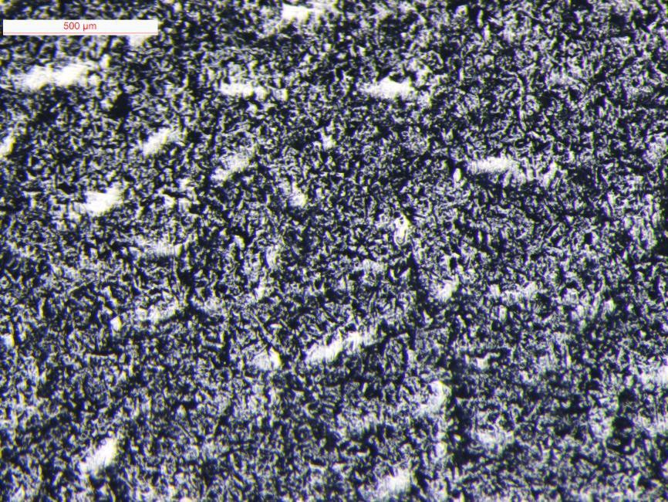
Gloss Issue on Textured Surface
Texture of part inner surface is more fine than that of outer surface
28

Slide 29
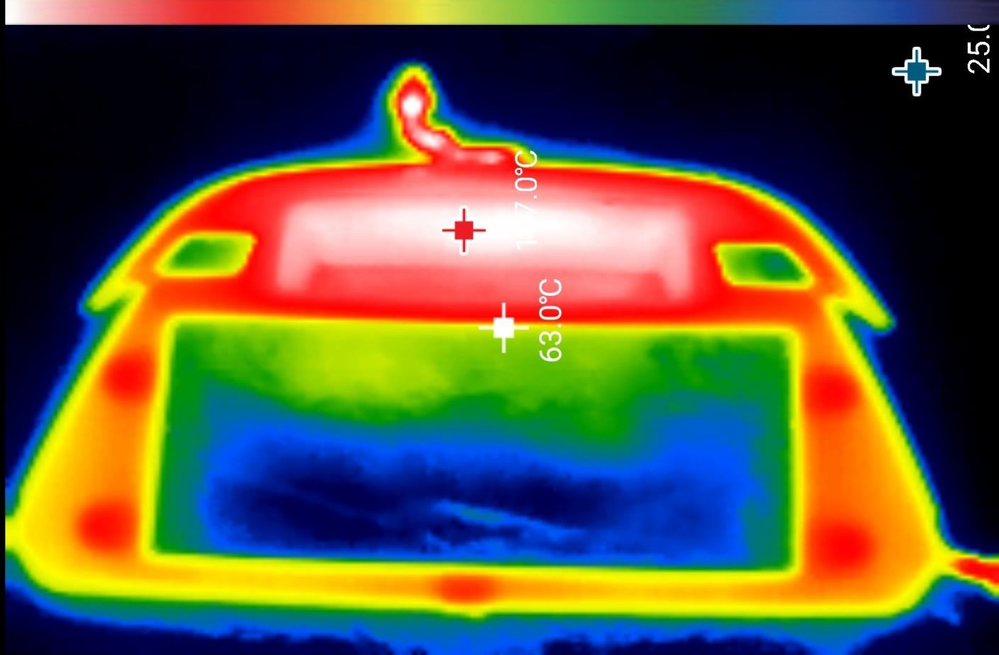
Surface Temp of Part after Demolding
29

Slide 30
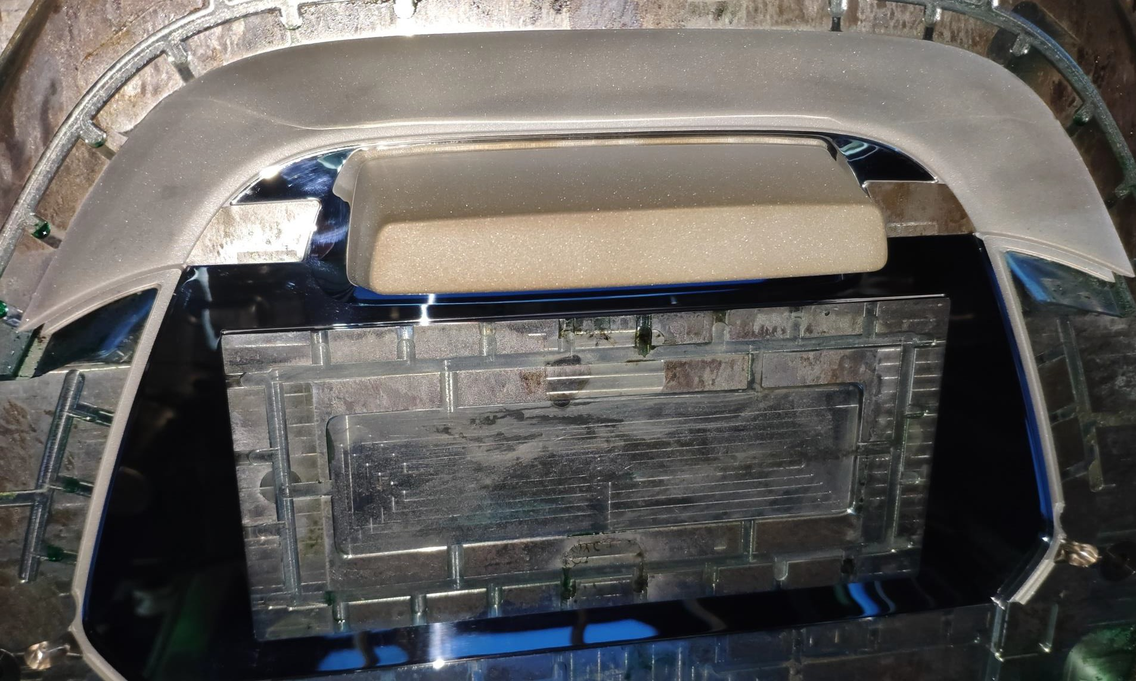
Analysis: Gloss issue on textured surface
Visual differences in gloss can be found between the 2 areas of tooling textured surface. Tool surface to part inner surface of concave looks more matt
Mold surface to inner surface Measured surface temp is 105 degree C when running
Mold surface to outer surface Measured surface temp is 75 degree C when running
30

Slide 31
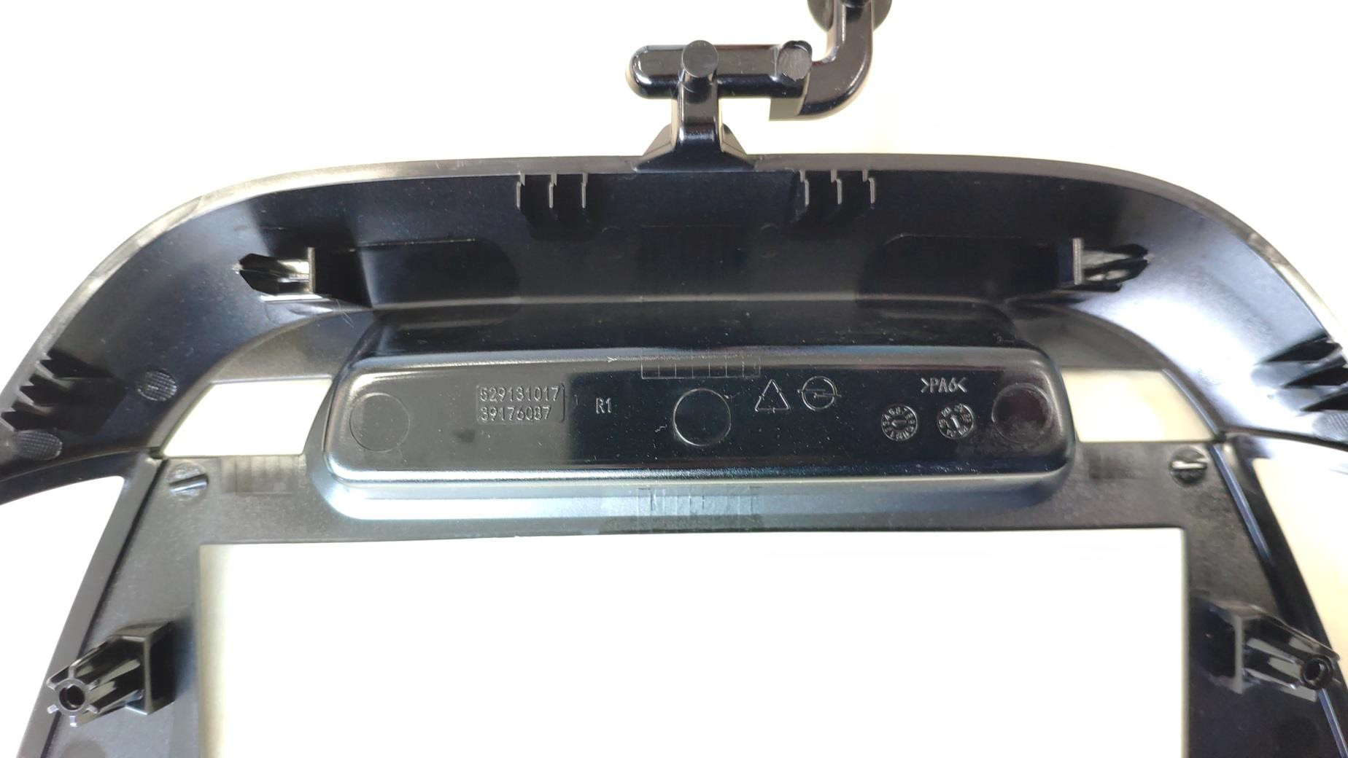
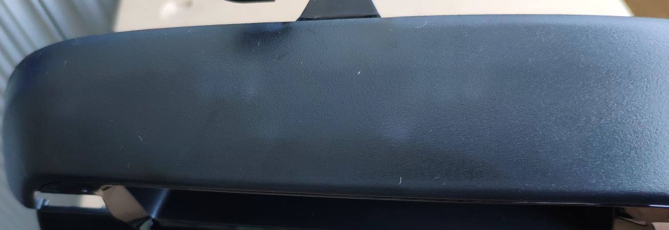
Analysis: Gloss issue on textured surface
Gloss difference on outer textured surface comes from stress mark where there were ribs or ejection lifter for bosses structure
31

Slide 32
Suggestion: Gloss Issue on Textured Surface
De-gloss to tooling surface relevant outer side surface
Apply same tooling surface temperature to eliminate the gloss difference between 2 areas if the same tooling surface texture was made
A higher tooling surface temp. would help to improve the “stress mark” where rib or lifter lies
32

Slide 33
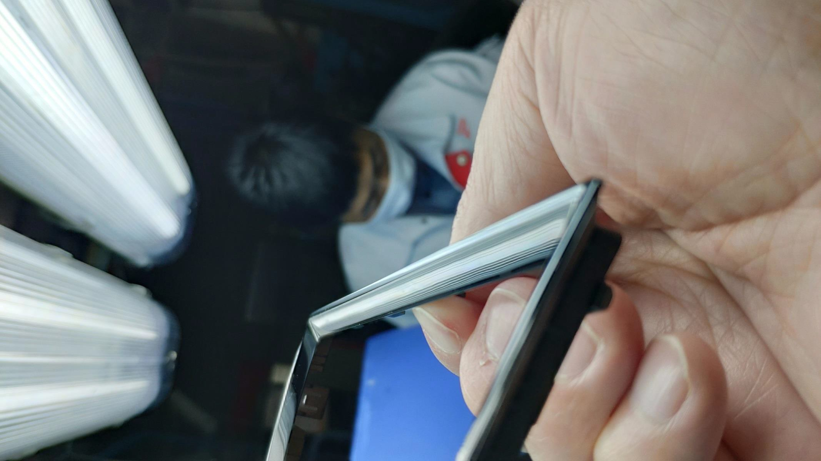
Sink Mark on High Gloss Surface
33

Slide 34
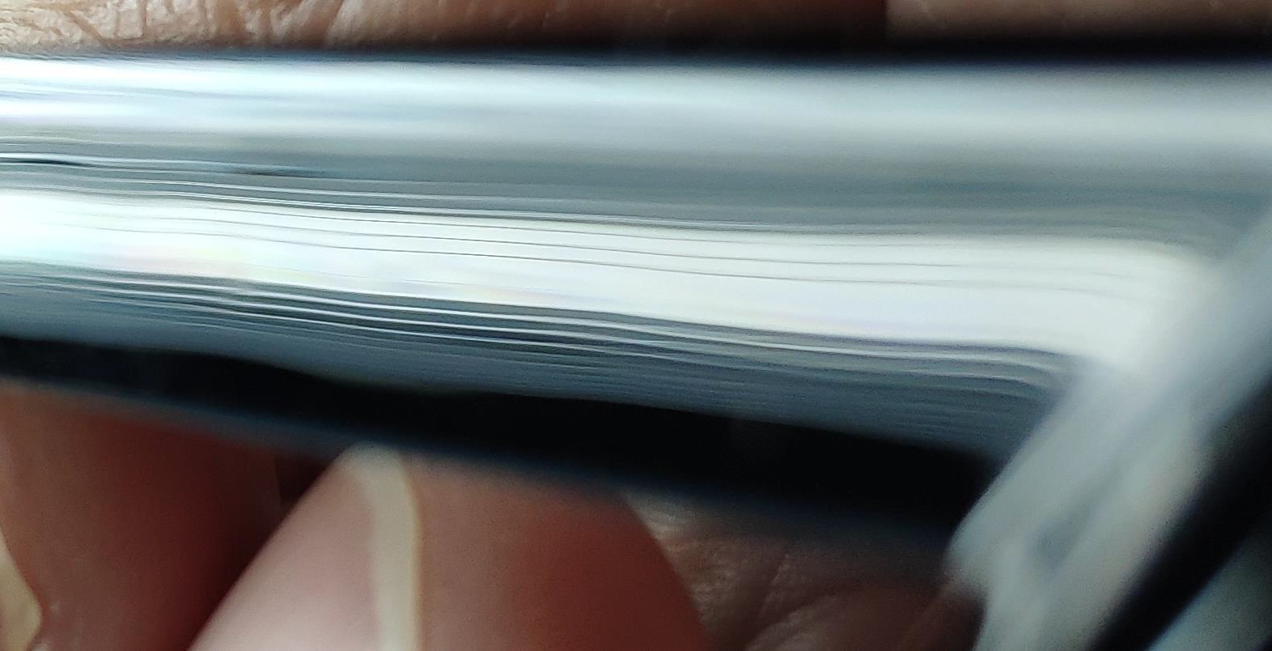
Sink Mark on High Gloss Surface
34

Slide 35
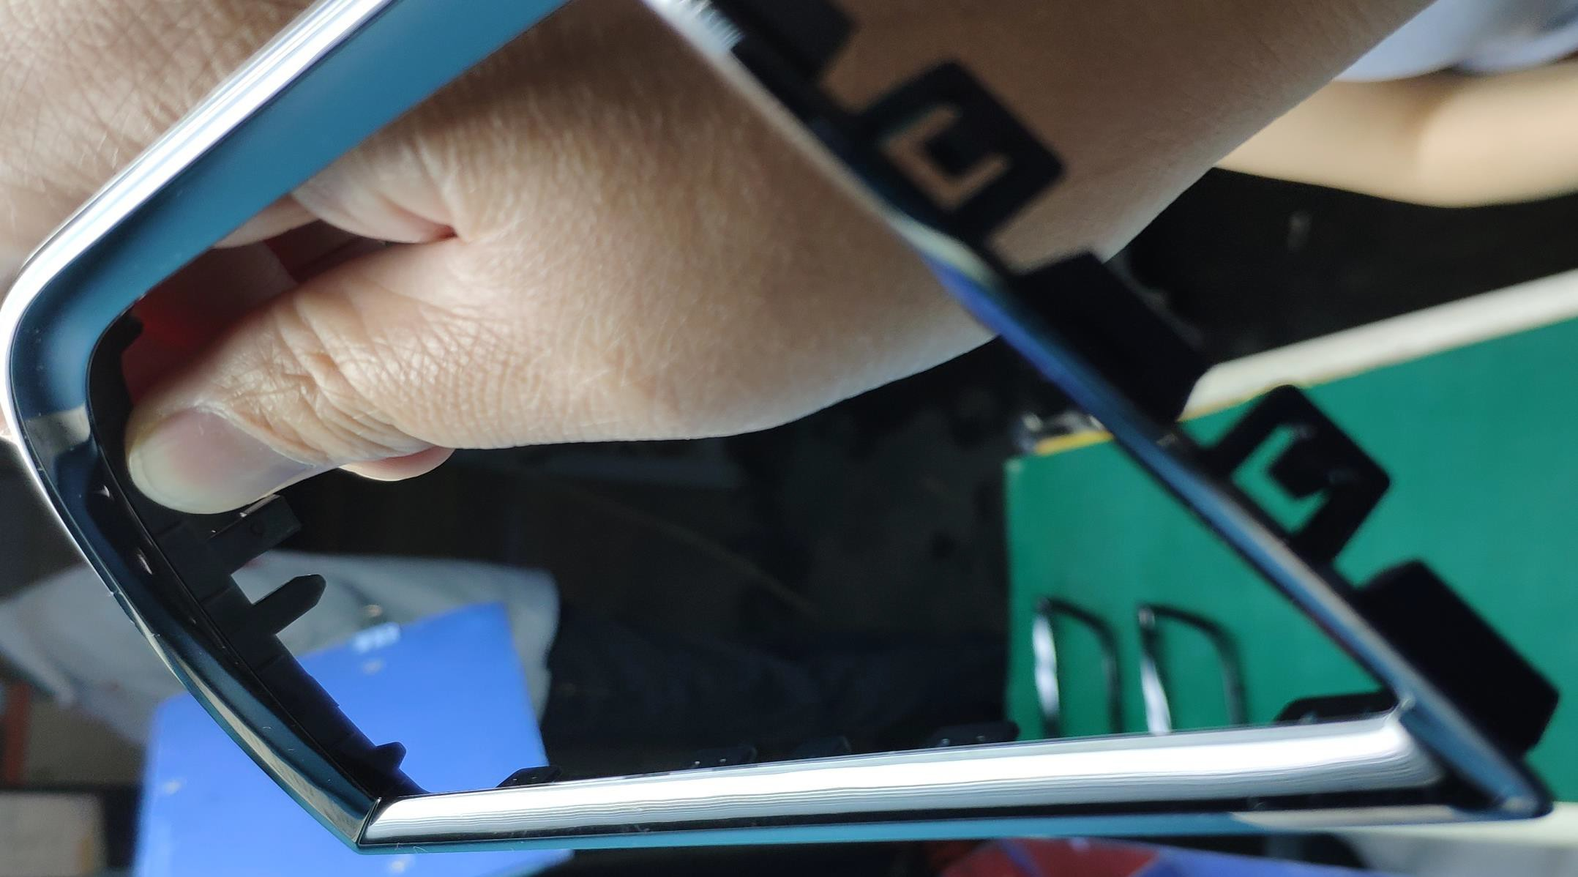
Sink Mark on High Gloss Surface
Ribs and different wall thickness at ejector side cause sink mark
35

Slide 36
Suggestion about Sink Mark
Optimize wall thickness of ribs and avoid sudden wall thickness variation
Enlarge gate size or multi-gate to ensure sufficient packing when cooling
36

Slide 37
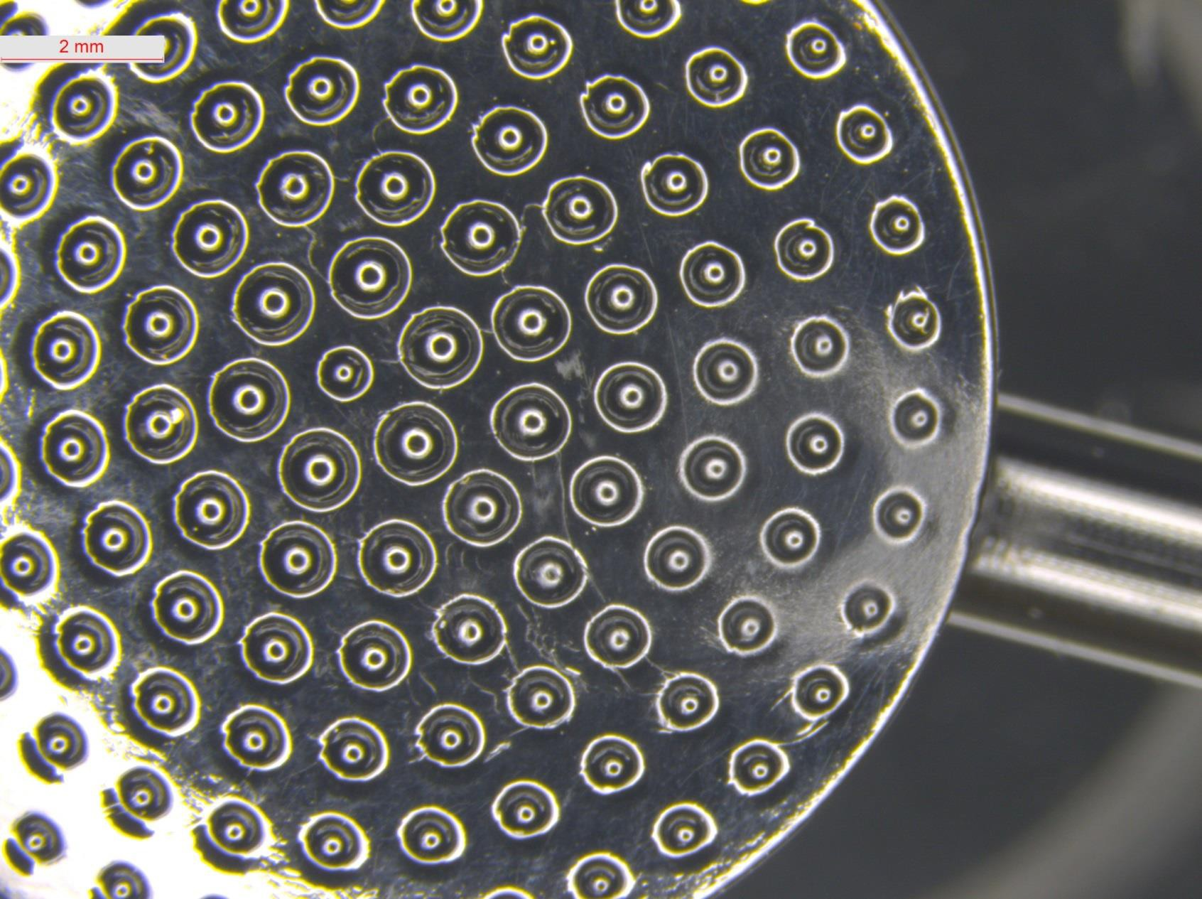
Flow Mark at Gate
37

Slide 38
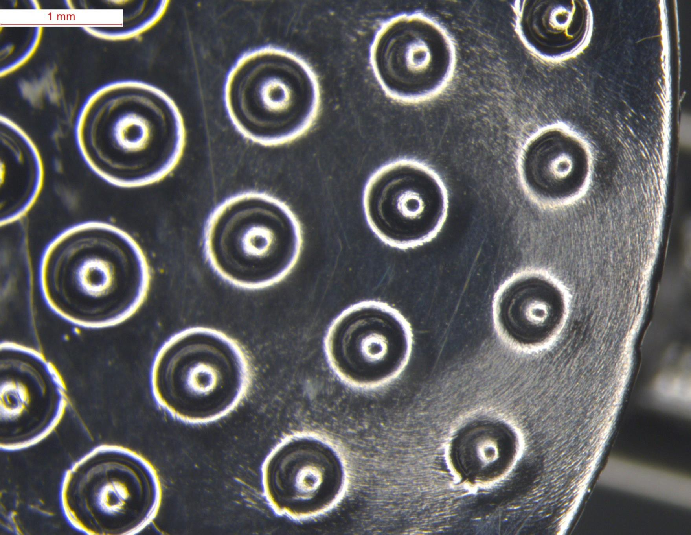
White Mark at Gate Area
38

Slide 39
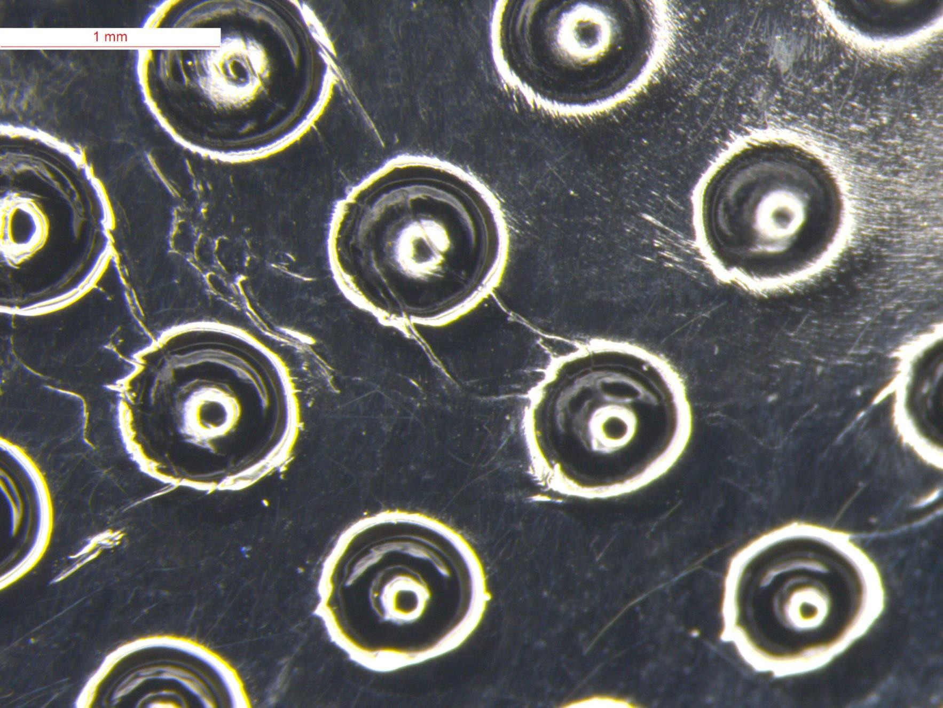
White Mark at Gate Area
39

Slide 40
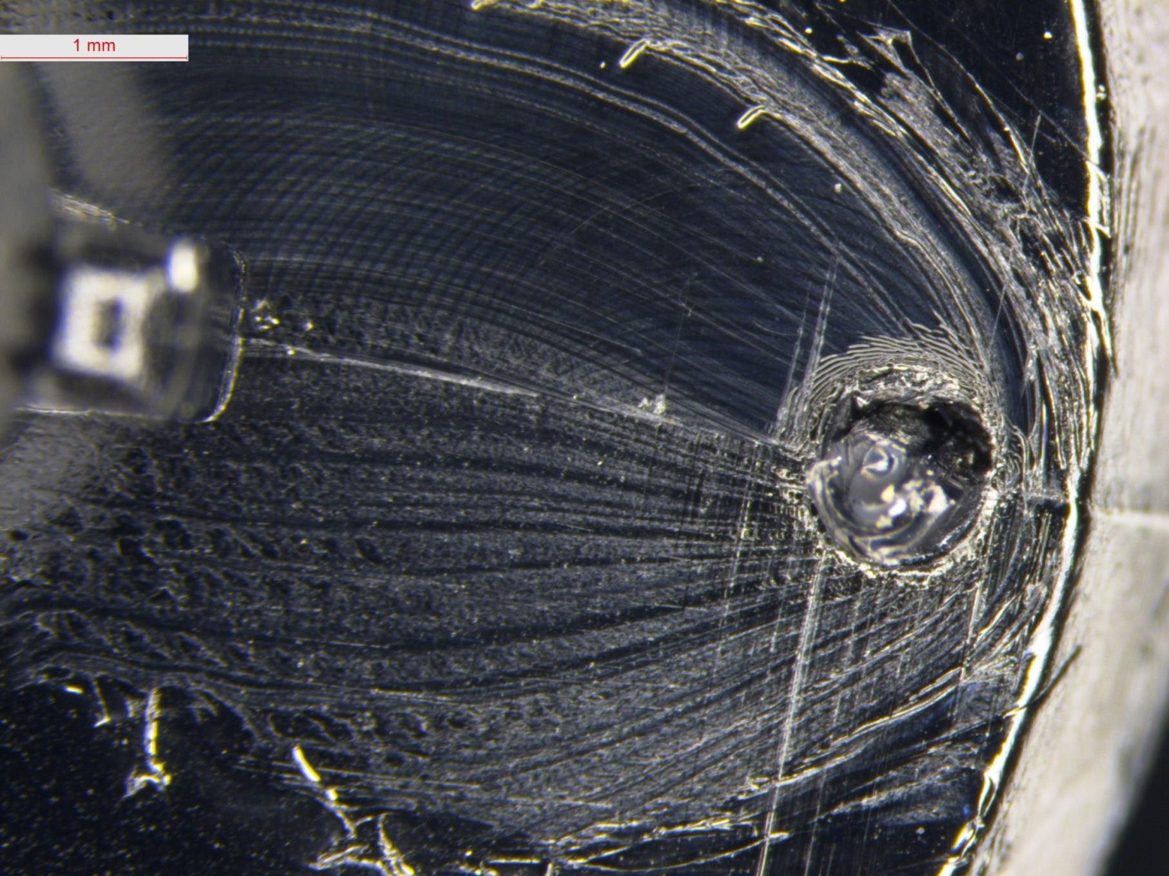
White Mark at Gate Area
40

Slide 41
Suggestion: White Mark at Gate Area
Enlarge gate size or change to side gate to avoid high pressure at gate point
Enlarge gate size to avoid thermal degradation
High mold surface temp. will help to improve the surface quality
41

Slide 42
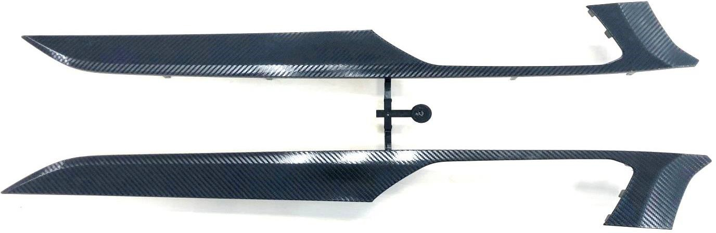
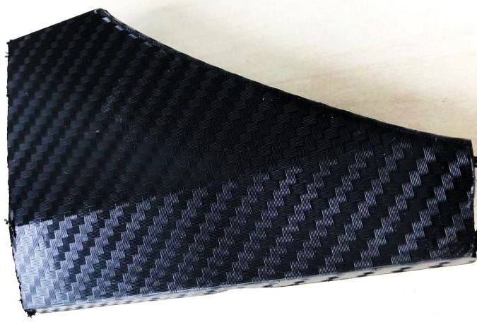
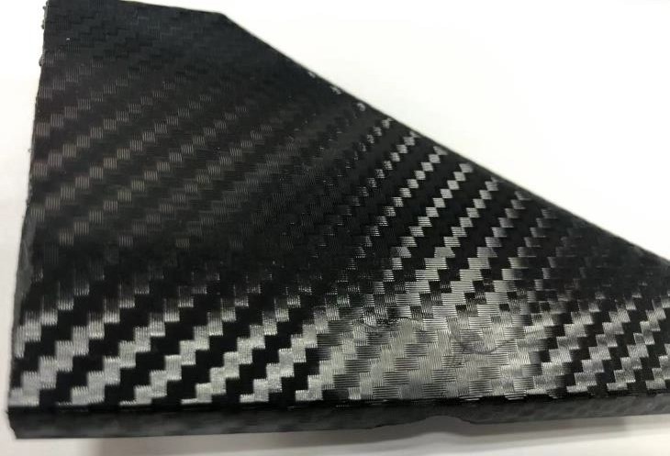
Flow Mark Occur at Gate Area after Heating in 80⁰C Water
PIC1: no flow mark at gate area before test
PIC2: flow mark occur at gate area after test
42

Slide 43
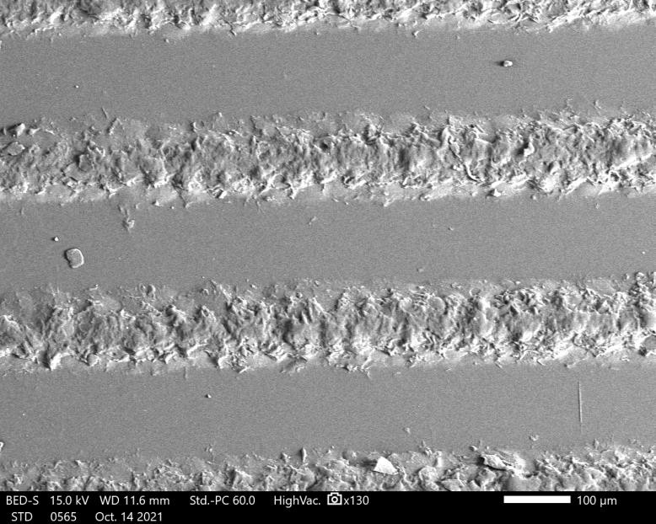

Flow Mark Occur at Gate Area after Heating in 80⁰C water – Observe by SEM
PIC1: before heating in 80C water
PIC2: after heating in 80C water
43

Slide 44


Test Polished Surface Part after Heating in 80⁰C Water
PIC1: Slight flow mark at part with polished surface before test
PIC2: more obvious flow mark at part with polished after test
44

Slide 45
Flow Mark at Gate area after Heating in 80⁰C Water – Analysis and Suggestion
Analysis: Flow mark is on the gate surface. But eyes can’t see it due to texture on the part surface. Heating in water makes flow mark became obvious.
Suggestion:
Filling part’s gate area with slow injection speed until flow mark can’t be seen by eyes if part is polished surface.
Texture surface: Heating part in 80⁰C water after molding
No flow mark at gate area, nothing to do.
Flow mark occur at gate area: fill part gate position in lower injection speed and lower mold temperature until flow mark can’t be seen by eyes. Then increase mold temperature 20-30⁰C to fill parts.
Enlarge gate size.
45

Slide 46
Disclaimer
The information contained in this report is based on our present know-ledge, experience and technology. The presented images, plot and data are guidance values and do not represent binding material specifications. No guarantee of the reliability for any info in this report being used in real world. The part maker is responsible for the quality and safety of final product and legal compliance.

